Slide 2
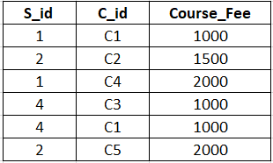
Second Normal Form (2NF)
In 2NF there should not be partial dependency.
The table first needs to be in 1NF.
Example:
S_id and C_id =composite primary key
Course_Fee = non primary attribute

Slide 3
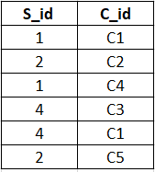
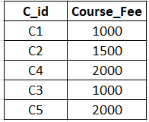
1. Student_Course Table
2. Courses Table

Slide 4
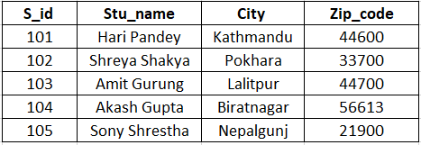
Third Normal Form (3NF)
In 3NF there should not be transitive dependency in the table.
The table first needs to be in 2NF.
Example:
S_id is a primary key
S_id → Zip_code → City

Slide 5
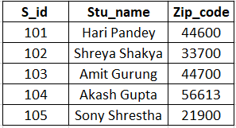
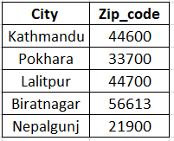
1. Student Table
2. City Table

